Slide 1
Race and Human Variation
Notes:
Today, we will talk about race. Specifically, we will talk about what race means and why it is not a good way to group people.

Slide 2
Human Variation
No two people are exactly the same.
This means that each of us varies from each other.
Some people have sought to group people based on the variation that they think is most important.
Like skin color
Notes:
Important Point: No two people are exactly the same. (Even identical twins are different from each other)
Each of us varies from each other. This means that each one of us has unique qualities that makes us different.
Important Point: Some people group others based on the qualities that they have deemed to be most important.
In America, skin color is a primary way people get lumped into broad categories that we call races.

Slide 3
What do we mean by race?
Race is a cultural construct: it is constructed by the culture that uses it to group people.
For example, here in America, we primarily group people into races based on skin color.
In America, race is grouped in five categories:
American Indian
Asian
Black
Hispanic/Latino/a
White
Notes:
Race is a cultural construct→ Though often based on appearance, how cultures group people differs,
In America, we use five categories (the five census categories): American Indian, Asian, Black, Hispanic/Latino, and White.
These are based largely on skin color where one’s appearance determines where they are placed.

Slide 4
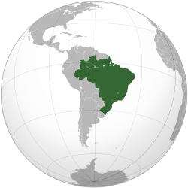
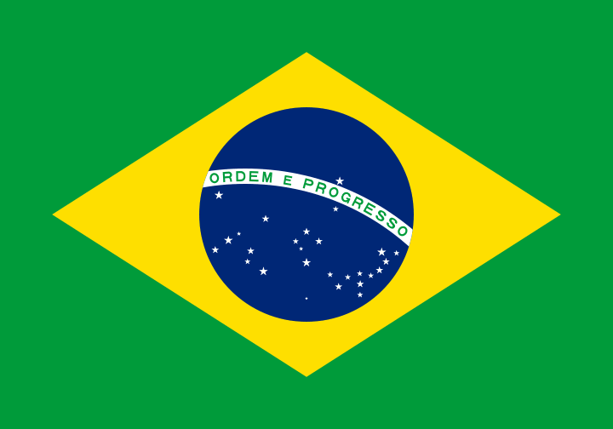
But, race is not always grouped like that!
However, Brazilians do not group people into five categories. Instead, they have 28 categories based on variations in skin color.
Notes:
However, not every culture uses just five “races.”
Brazil has a complex racial categorization system with 28 categories based on gradients of skin color.
It allows people to fall in-between categories more than the American system does.
Rather than based on broad, firm categories of skin color, this system is based more on gradients between categories: On slight differences between skin color.

Slide 5
Clines
Though appearance often determines how someone is grouped into races, race itself cannot describe all that makes each of us different.
Race is not a useful way to describe all the differences observed in humans.
As anthropologists, we use clines to describe variation in human biology.
A cline is a gradient of change.
Rather than attempt to group humans into broad categories based only on a few traits as race does, clines show how variation is spread across the map without clear boundaries.
Notes:
Since race is culturally constructed, means different things in different cultures, and is based on broad categories that cannot describe the full complexity of how we differ from each other.
It is not useful to describe differences between humans
Anthropologists do not use race to describe human variation. We use clines instead.
A cline is any gradient of change. Rather than constructing broad groups that we force people to fit into, clines cannot be described as broad categories.
Instead, clines look at how variation is mapped out in the world. How people differ in both small and large ways from one area to the next. Most people are more similar to their neighbors than they are to more distant people. But, there exists graduations between every group.

Slide 6
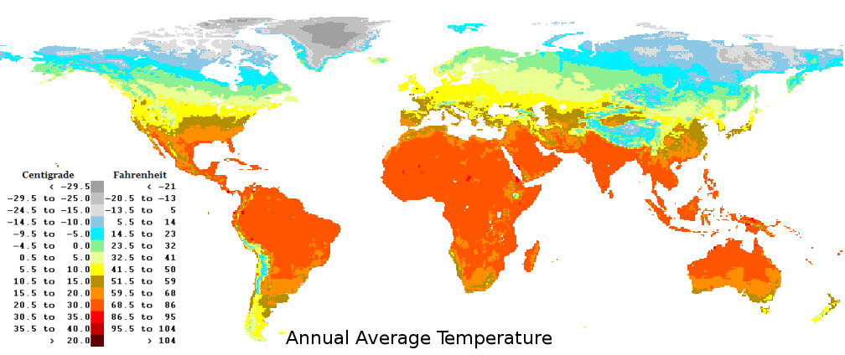
Notes:
This is a map of global temperatures. It has nothing to do with humans but is an example of a cline. As you can see, by the number of different colors on the map, there is a wide diversity of temperatures across the world. However, there are general trends: hotter temperatures can be seen closer to the equator (the center of the map) represented by dark orange and colder temperatures exist further north represented by lighter colors. However, there are gradations between the hottest and coldest temperatures. There is a whole range of temperatures in between represented by intermediate colors between the hottest and coldest regions. Areas closer to the hottest regions tend to be warmer than areas closer to the coldest area. Overall though, the temperatures blend together to the point that it is impossible to draw completely accurate divisions between areas based on temperature.

Slide 7
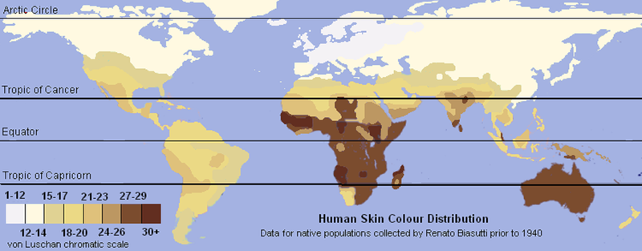
Notes:
Likewise, skin color as it is distributed across the globe is a cline. Like the temperature map, darker skin colors tend to be found closer to the equator and paler colors in the far north. However, there are gradations between the darkest and palest skin colors that show the wide variation in skin colors present in humans. The variation is so greatly spread over the map that it is impossible to classify people based purely on skin color in ways that are useful. We call this a cline.

Slide 8
How would you group them?
Now, we will try and group people based on the race that you think they should be grouped as.
We will use the 5 categories defined by the U.S. census:
American Indian
Asian
Black
Hispanic/Latino
White
Sort the pictures provided into these categories.
Notes:
Key:
American Indian: 1, 7, 12, 17
Asian: 16, 8, 5, 15
Black: 4, 13, 3, 9
Hispanic/Latino: 2, 6, 10, 20
White: 14, 18, 19, 11
Key Point: These categories are not useful for grouping people.

